Slide 1

Lecture 2
Fundamentals and Applications (CSO201A)
Dr. Srinivas Dharavath
Assistant Professor
Department of Chemistry
Indian Institute of Technology, Kanpur
Kanpur- 208016
E-mail: srinivasd@iitk.ac.in

Slide 2

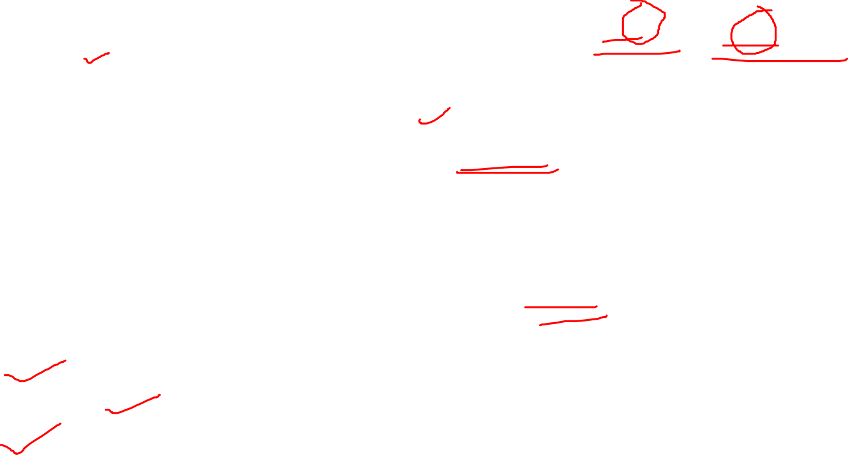
Functional Groups
A functional group is an atom or a group of atoms with characteristic chemical and physical properties.
Most organic molecules contain a carbon backbone consisting of C—C and C—H bonds to which functional groups are attached.
Structural features of a functional group include:
Heteroatoms—atoms other than carbon or hydrogen.
Bonds most commonly occur in C—C and C—O double bonds.
Functional Groups-1
Functional groups distinguish one organic molecule from another.
They determine a molecule’s:
Geometry
Physical properties
Reactivity
Organic Chemistry Sixth Edition, Janice Gorzynski Smith University of Hawai’I Chapter 1,3 and 6

Slide 3
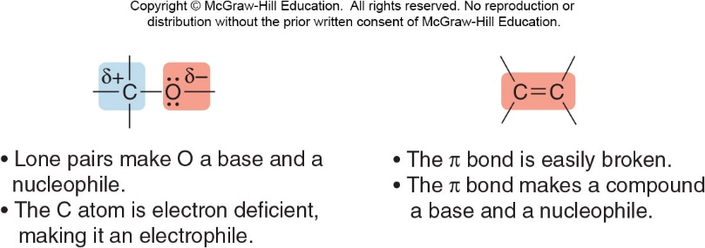

Reactivity of Functional Groups
Heteroatoms and bonds confer reactivity on a particular molecule.
Heteroatoms have lone pairs and create electron-deficient sites on carbon.
A bond makes a molecule a base and a nucleophile, and is easily broken in chemical reactions.
Organic Chemistry Sixth Edition, Janice Gorzynski Smith University of Hawai’I Chapter 1,3 and 6

Slide 4
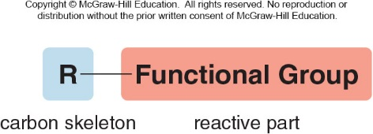
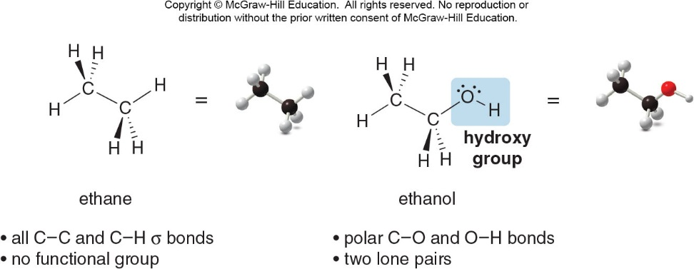
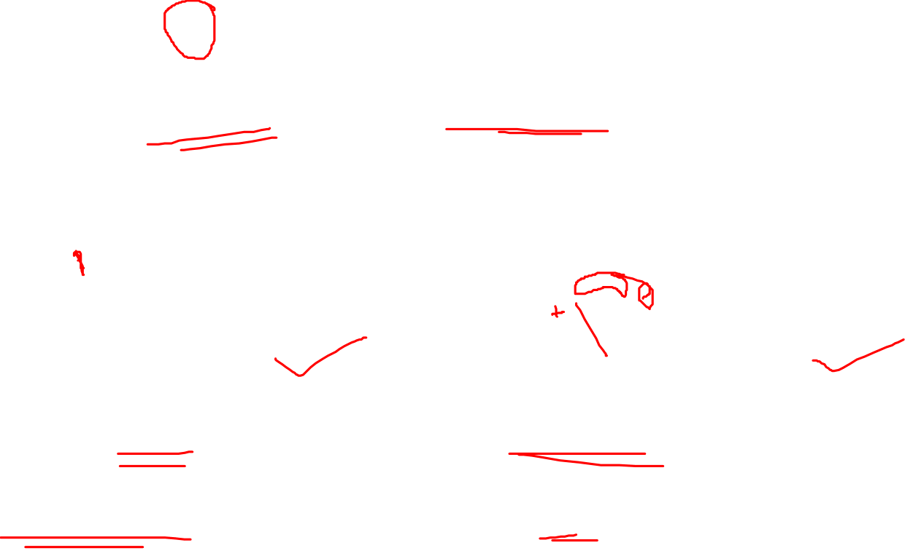
Parts of a Functional Group
Organic Chemistry Sixth Edition, Janice Gorzynski Smith University of Hawai’I Chapter 1,3 and 6

Slide 5
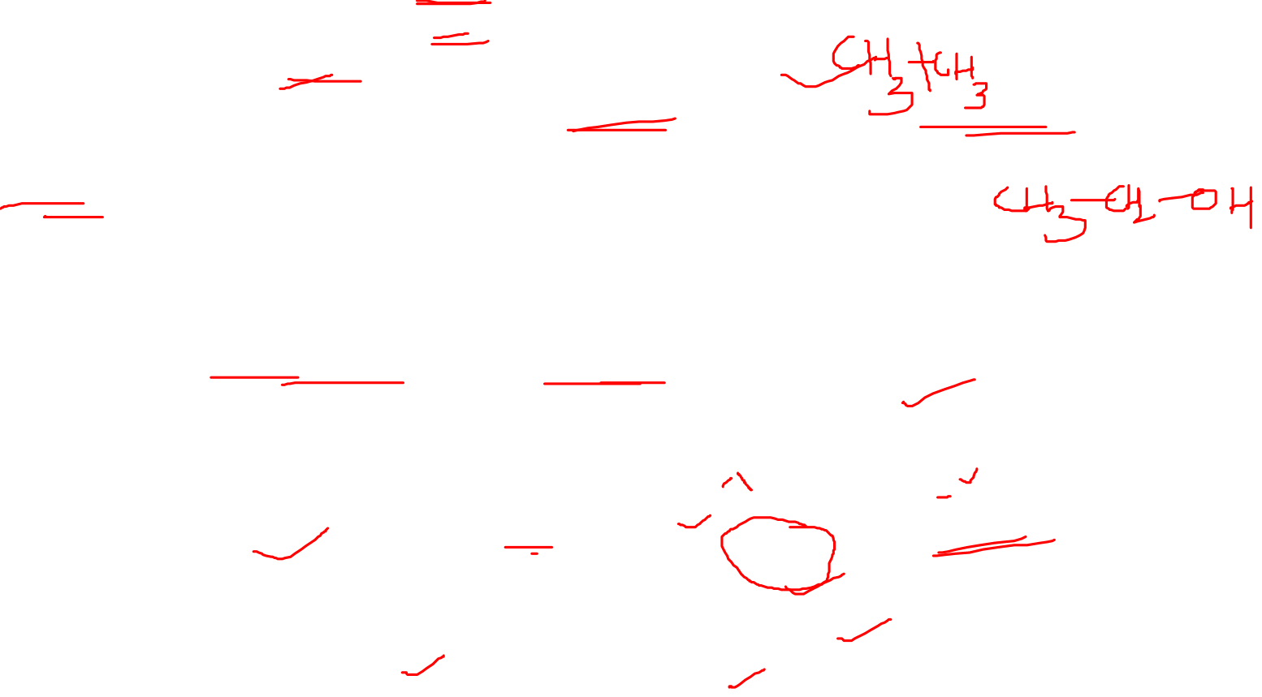
Ethane, a Molecule with No Functional Group
This molecule has only C—C and C—H bonds.
It contains no polar bonds, lone pairs, or bonds.
Therefore, ethane has no reactive sites (functional groups).
Consequently, ethane and other alkanes are very unreactive.
Ethanol
This molecule has an OH (called a hydroxy group) attached to its backbone.
Compounds containing an OH group are called alcohols.
The hydroxy group makes the properties of ethanol very different from the properties of ethane.
Ethanol has lone pairs and polar bonds that make it reactive.
Other molecules with hydroxy groups will have similar properties to ethanol.
Ethanol-1
Organic Chemistry Sixth Edition, Janice Gorzynski Smith University of Hawai’I Chapter 1,3 and 6

Slide 6
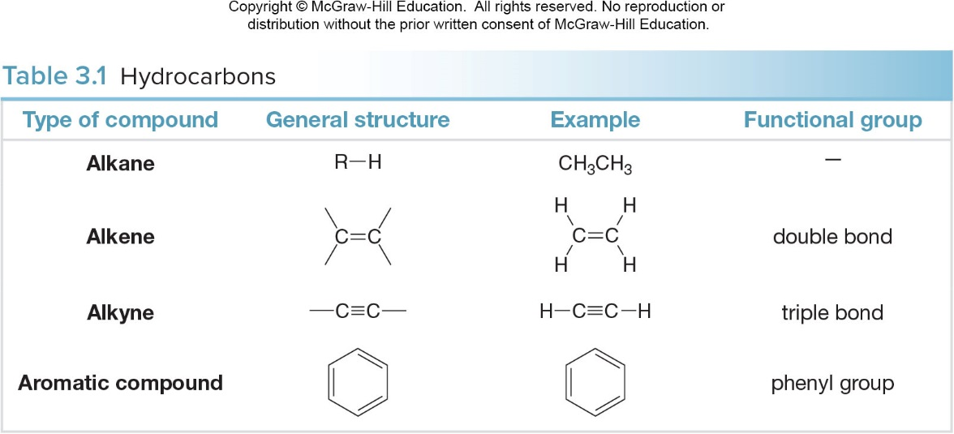

Hydrocarbons
Hydrocarbons are compounds made up of only the elements carbon and hydrogen.
They may be aliphatic (ex. alkanes, alkenes, alkynes) or aromatic.
Aliphatic Hydrocarbons
Aliphatic hydrocarbons have three subgroups.
Alkanes have only C—C bonds and no functional group.
Alkenes have a C—C double bond.
Alkynes have a C—C triple bond.
Organic Chemistry Sixth Edition, Janice Gorzynski Smith University of Hawai’I Chapter 1,3 and 6

Slide 7
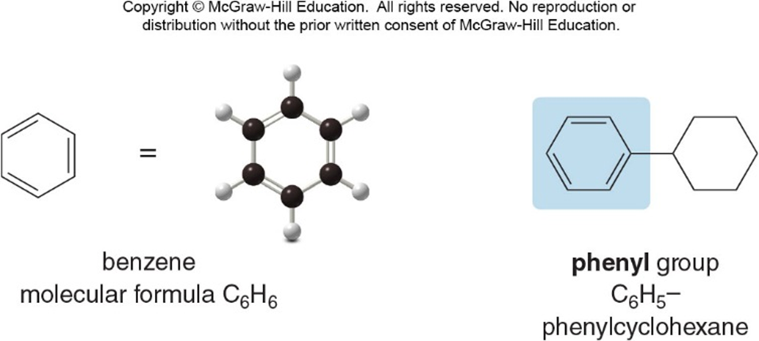
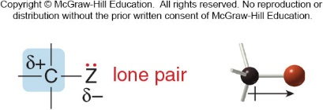
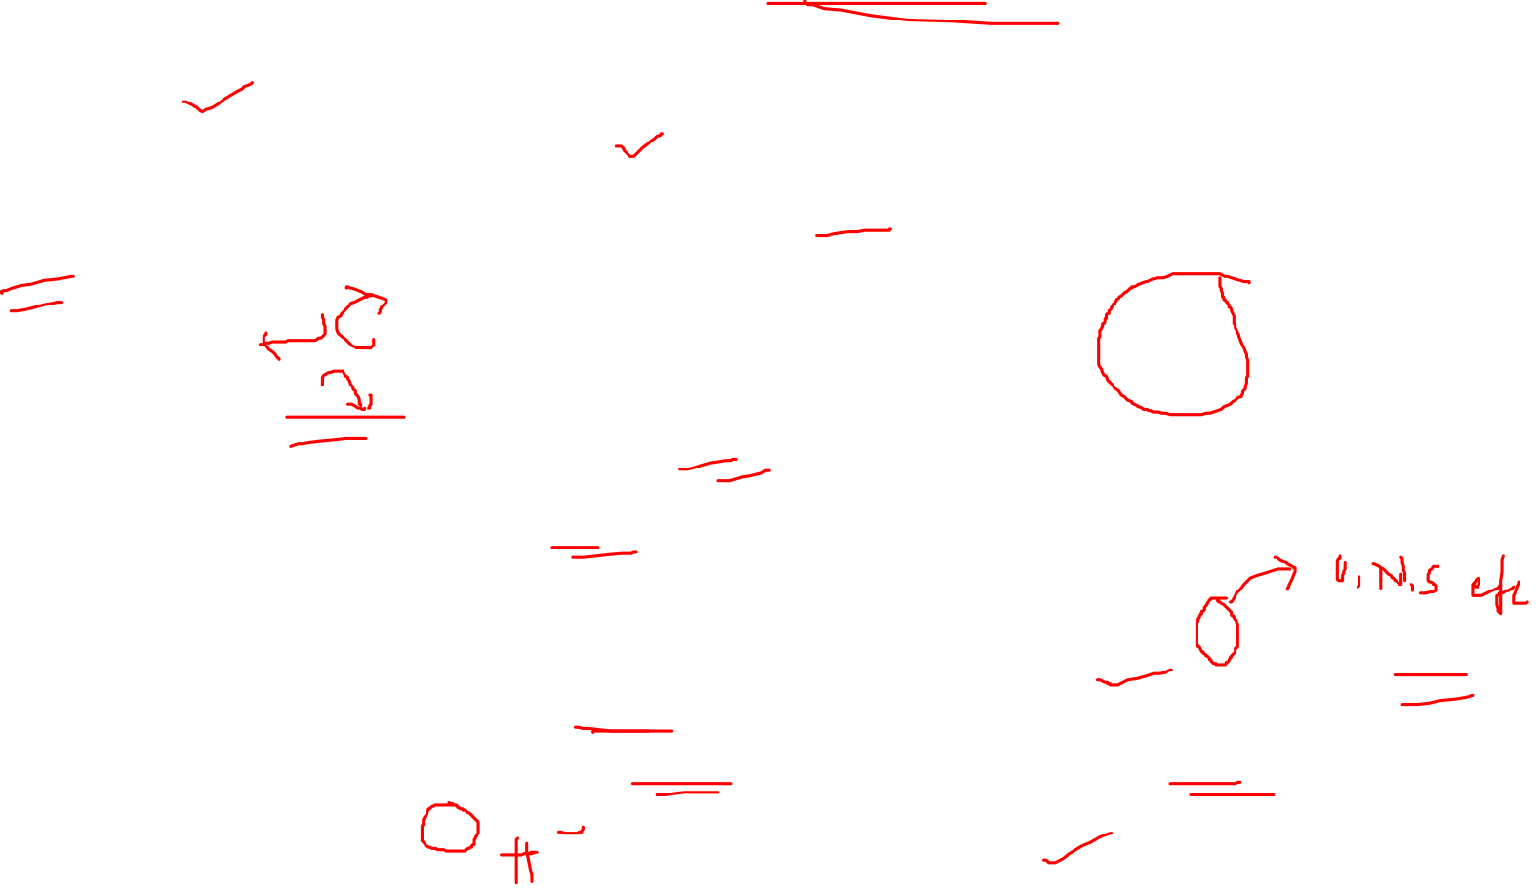
Aromatic Hydrocarbons
Aromatic hydrocarbons are so named because many of the earliest known aromatic compounds had strong, characteristic odors.
The simplest aromatic hydrocarbon is benzene.
The six-membered ring and three bonds of benzene comprise a single functional group, found in most aromatic compounds.
Functional Groups with Carbon- Heteroatom (𝐂−𝐙) 𝝈 bonds
Several types of functional groups contain C—Z bonds.
The electronegative heteroatom Z creates a polar bond, making carbon electron deficient.
Organic Chemistry Sixth Edition, Janice Gorzynski Smith University of Hawai’I Chapter 1,3 and 6

Slide 8
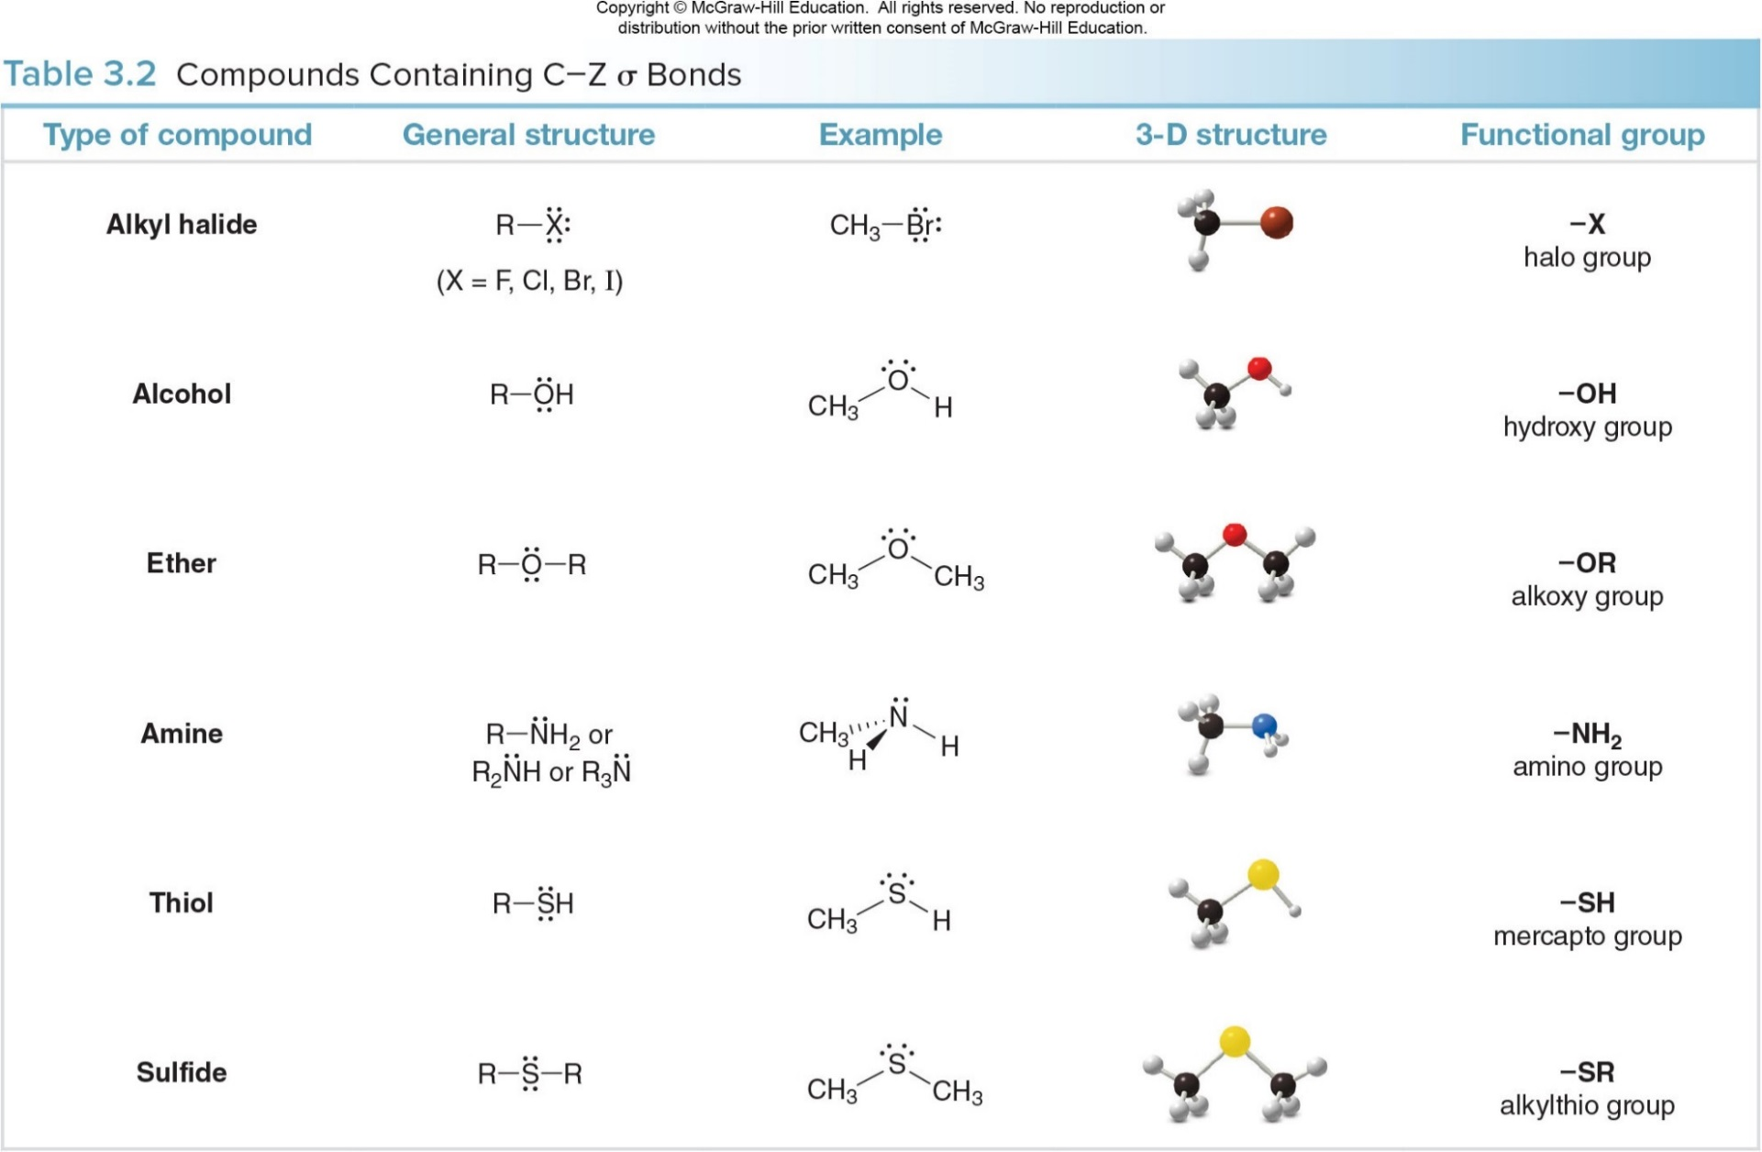

Functional Groups with 𝐂−𝐙 𝝈 bonds
Organic Chemistry Sixth Edition, Janice Gorzynski Smith University of Hawai’I Chapter 1,3 and 6

Slide 9
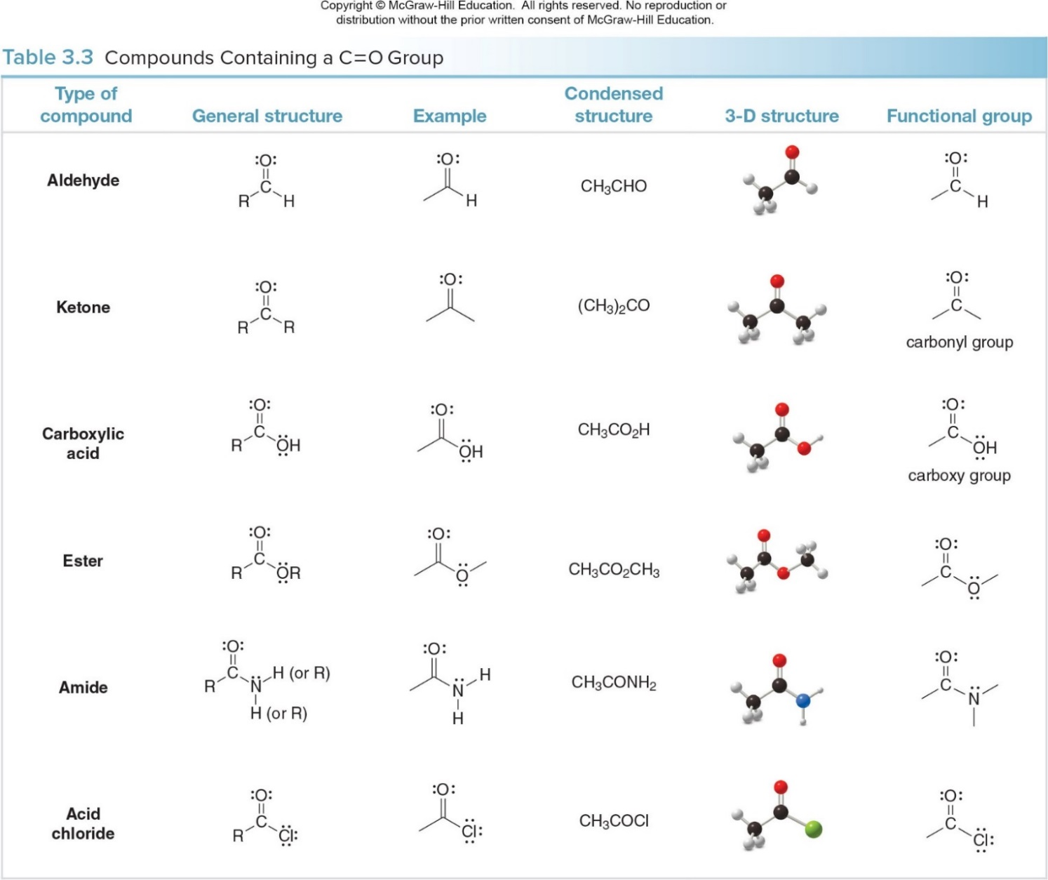
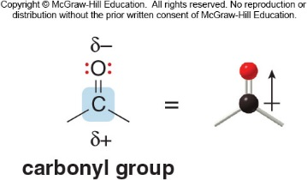
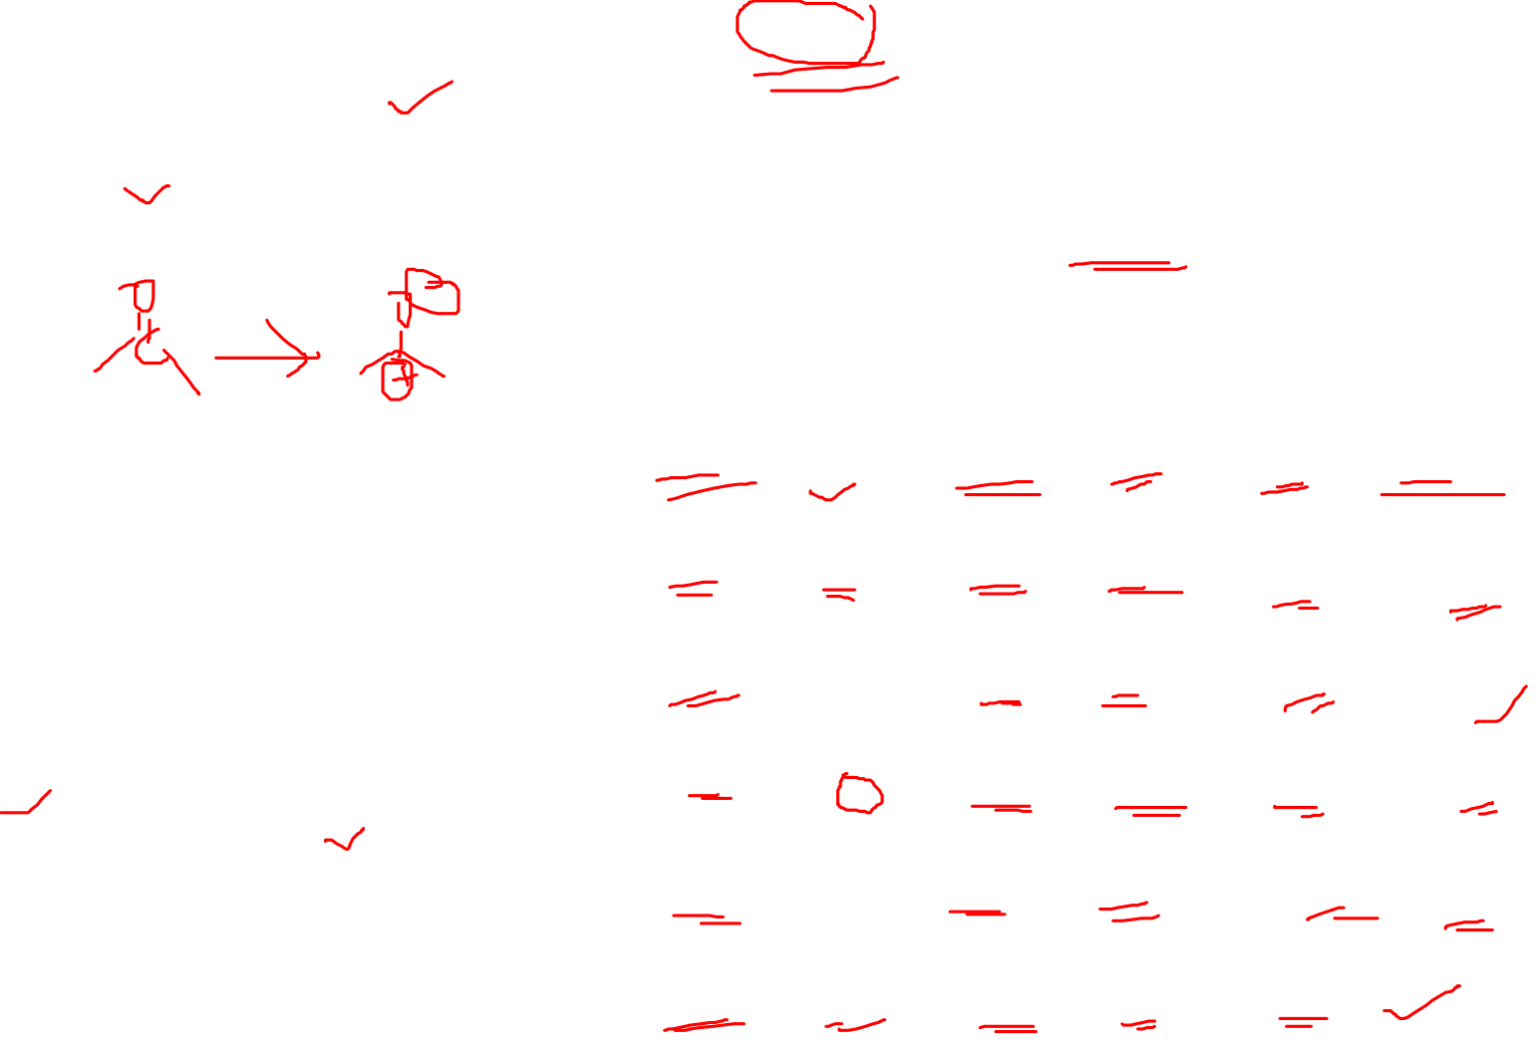
Functional Groups with 𝐂=𝐎 Group
This group is called a “carbonyl group”.
The polar C—O bond makes the carbonyl carbon an electrophile, while the lone pairs on O allow it to react as a nucleophile and base.
The carbonyl group also contains a bond that is more easily broken than a C—O bond.
Functional Groups with 𝐂=𝐎 Group-1
Organic Chemistry Sixth Edition, Janice Gorzynski Smith University of Hawai’I Chapter 1,3 and 6

Slide 10
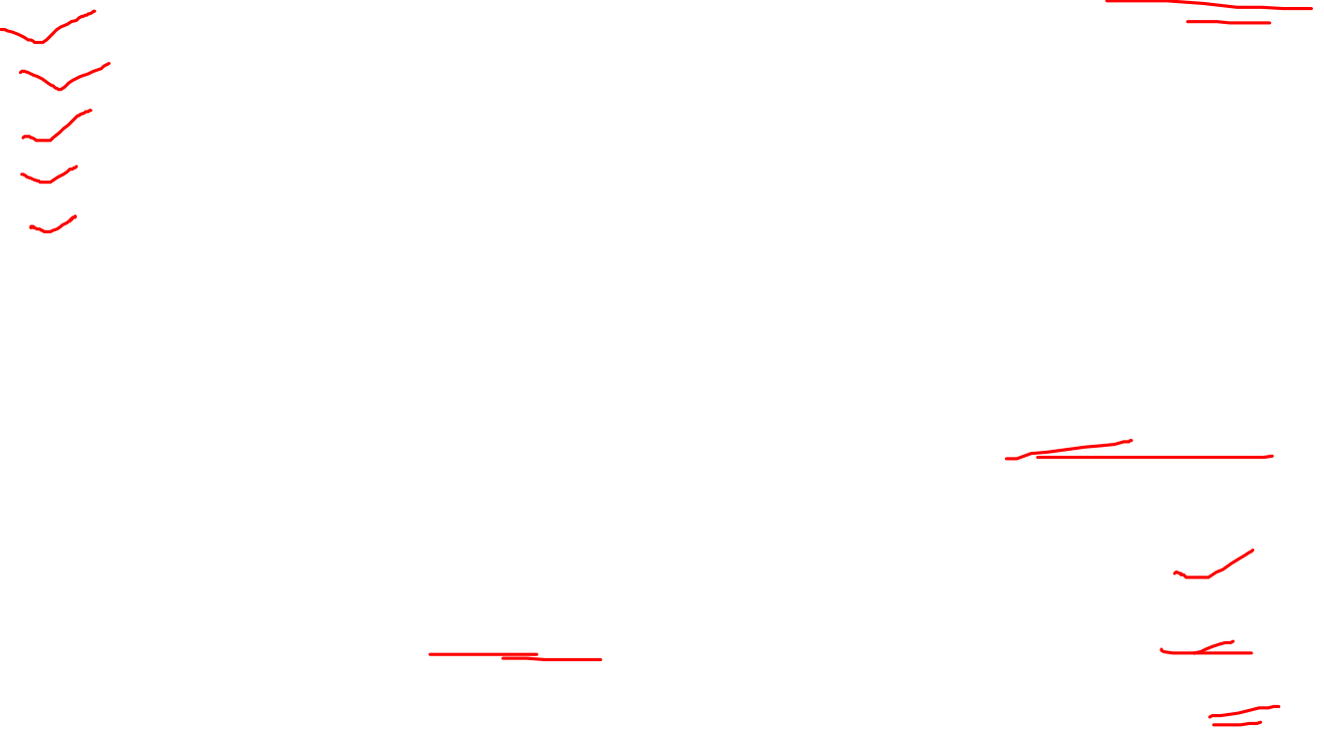
Importance of Functional Groups
A functional group determines all of the following properties of a molecule:
bonding and shape
type and strength of intermolecular forces
physical properties
nomenclature
chemical reactivity
Intermolecular Forces
Intermolecular forces are interactions that exist between molecules.
Functional groups determine the type and strength of these interactions.
Ionic and covalent compounds have very different intermolecular interactions.
Organic Chemistry Sixth Edition, Janice Gorzynski Smith University of Hawai’I Chapter 1,3 and 6

Slide 11
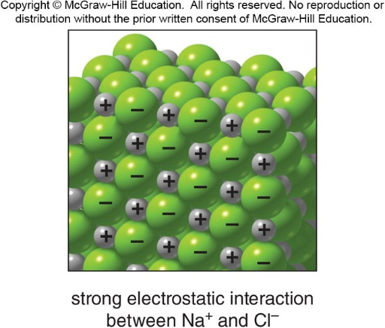

Ion-Ion Interactions
Ionic compounds contain oppositely charged particles held together by extremely strong electrostatic interactions.
These ionic interactions are much stronger than the intermolecular forces present between covalent molecules.
Organic Chemistry Sixth Edition, Janice Gorzynski Smith University of Hawai’I Chapter 1,3 and 6

Slide 12

Intermolecular Forces in Covalent Molecules
Covalent compounds are composed of discrete molecules.
The nature of the forces between molecules depends on the functional group(s) present.
There are three different types of interactions, shown below in order of increasing strength:
van der Waals forces
dipole-dipole interactions
hydrogen bonding
Vander Wal Forces
van der Waals forces are also known as London forces.
They are very weak interactions caused by momentary changes in electron density in a molecule.
They are the only attractive forces present in nonpolar compounds.
Organic Chemistry Sixth Edition, Janice Gorzynski Smith University of Hawai’I Chapter 1,3 and 6

Slide 13
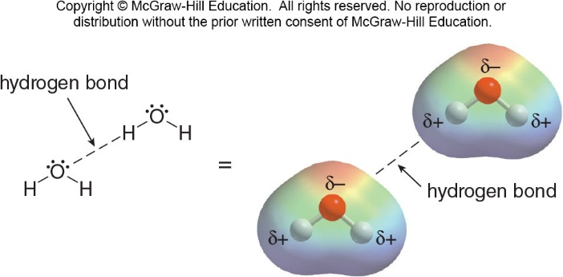
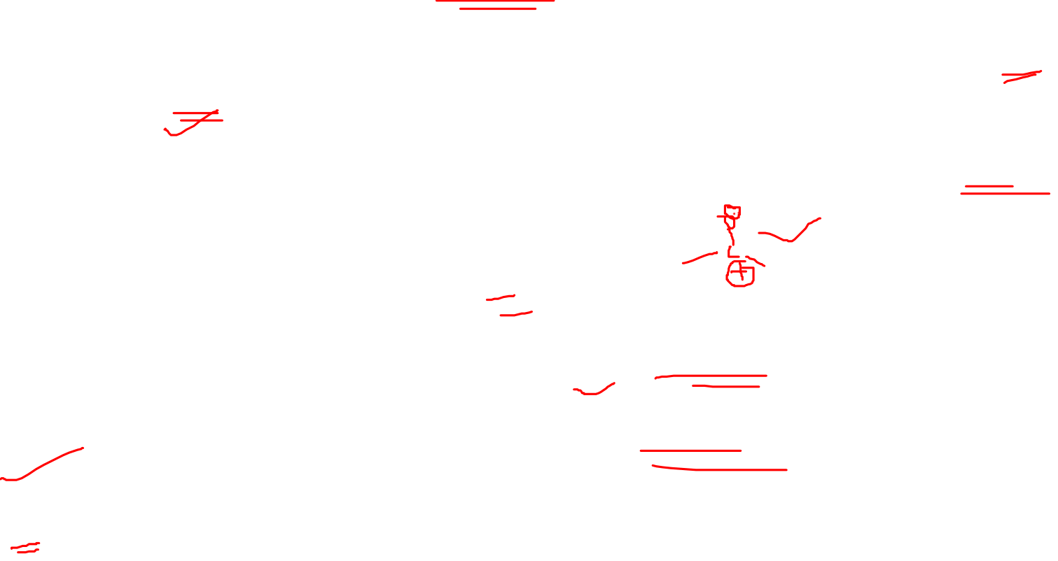
Dipole-Dipole Interactions
Dipole-dipole interactions are the attractive forces between the permanent dipoles of two polar molecules.
The dipoles in adjacent molecules (e.g., acetone below) align so that the partial positive and partial negative charges are in close proximity.
These attractive forces caused by permanent dipoles are much stronger than weak van der Waals forces.
Hydrogen Bonding
Hydrogen bonding typically occurs when a hydrogen atom bonded to O, N, or F, is electrostatically attracted to a lone pair of electrons on an O, N, or F atom in another molecule.
Hydrogen bonding is the strongest of the three types of intermolecular forces.
Organic Chemistry Sixth Edition, Janice Gorzynski Smith University of Hawai’I Chapter 1,3 and 6

Slide 14
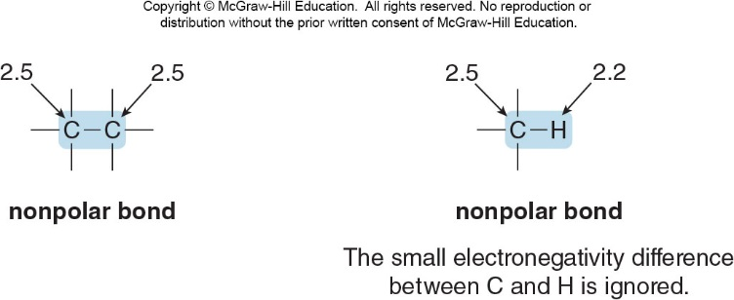

Bond Polarity
Electronegativity values are used to indicate whether the electrons in a bond are equally shared or unequally shared between two atoms.
When electrons are equally shared, the bond is nonpolar.
Organic Chemistry Sixth Edition, Janice Gorzynski Smith University of Hawai’I Chapter 1,3 and 6

Slide 15
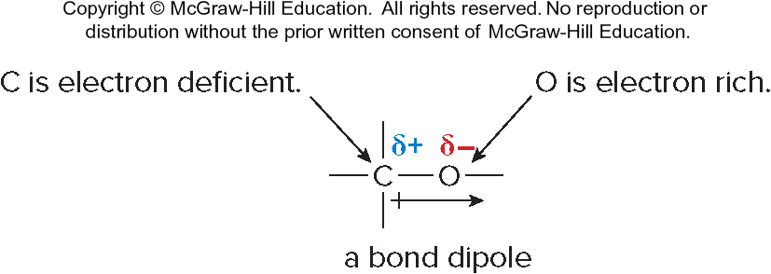
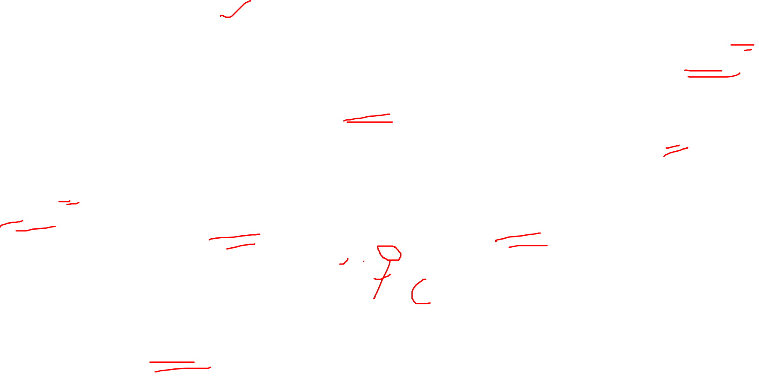
Nonpolar Bonds
A carbon—carbon bond is nonpolar.
C—H bonds are considered to be nonpolar because the electronegativity difference between C and H is small.
Whenever two different atoms having similar electronegativities are bonded together, the bond is nonpolar.
Polar Bonds
Bonding between atoms of different electronegativity values results in unequal sharing of electrons.
Example: In the C—O bond, the electrons are pulled away from C (2.5) toward O (3.4), the element of higher electronegativity. The bond is polar, or polar covalent. The bond is said to have dipole; that is, partial separation of charge.
A C—O bond is a polar bond.
Organic Chemistry Sixth Edition, Janice Gorzynski Smith University of Hawai’I Chapter 1,3 and 6

Slide 16
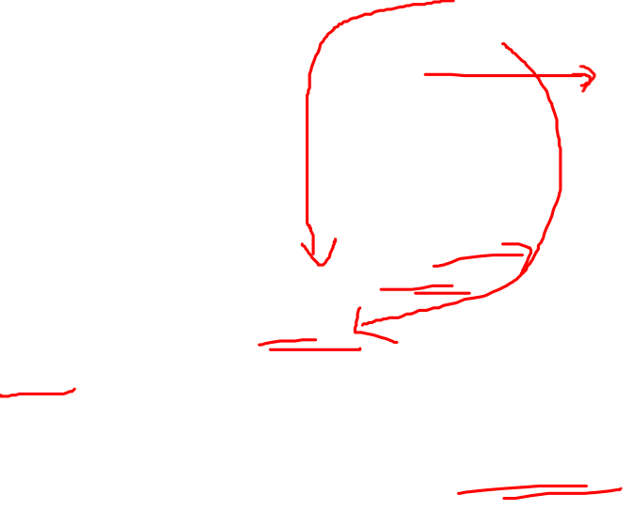
Depicting Polarity
The δ+ means the indicated atom is electron deficient.
The δ− means the indicated atom is electron rich.
The direction of polarity in a bond is indicated by an arrow with the head of the arrow pointing towards the more electronegative element.
The tail of the arrow is drawn at the less electronegative element.
Organic Chemistry Sixth Edition, Janice Gorzynski Smith University of Hawai’I Chapter 1,3 and 6

